Slide 1

Course topics:
HTML
CSS
UX/UI design
JavaScript

Slide 2
Validate your HTML:
https://validator.w3.org/

Slide 3
Publish your html:
Make sure you don’t have anything mapped to root mapping
Create public directory in resources folder
Create index.html in public directory

Slide 4
Sample html:
<!DOCTYPE html> <html lang="en"> <head> <meta charset="UTF-8"> <title>Title</title> </head> <body> </body> </html>

Slide 5
HTML

Slide 6
What is HTML
Hypertext Markup Language Interpreted by web browsers
Originally based on SGML(Standard Generalized markup language)
Hyperlinks are what makes the web go round
Spoken into two ways
Client Side
A person perspective
Server Side
Data storage perspective
Notes:
1.Client side: Who access a website
2.Server side: information/data that is stored in a computer (server) and later is distributed to clients (users)
6

Slide 7
Versions of HTML
Quirks Mode
HTML 2.0
HTML 3.2
HTML 4.01
HTML5
Notes:
1.Quirks mode works on different browsers and supports everything virtually that looks like HTML. But quirks mode result rendering different pages in different browsers
2. HTML 2.0 was introduced 1995, it was the first standard version and was good for codifying existing practice
3. HTML 3.2 was the first version which was radifyed by world wide web and it was radified in 1997
4. 4.01 was unveiled a year after to fix some issues
5. 14 years after HTML 4 , 5 has been released
7

Slide 8
Attributes
Attribute | value | description
charset | Character_set | Specifies the character encoding for the HTML document
content | text | Gives the value associated with the http-equiv or name attribute
http-equiv | Content-type Default-style refresh | Provides an HTTP header for the information/value of the content attribute
name | Application-name Author Description Generator keywords | Specifies a name for the metadata
scheme | Format/URI | Not supported in HTML5. Specifies a scheme to be used to interpret the value of the content attribute
Notes:
Global attributes in HTML5: http://www.w3schools.com/tags/ref_standardattributes.asp
8

Slide 9
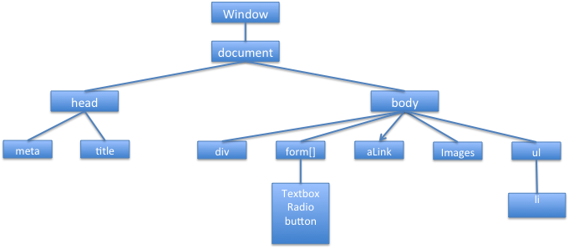
Understanding structure
Notes:
-HTML pages are like text documents
-it is very similar to a book -> head, headings, subheadings, test, images, videos and etc
-HTML describes the structure of the documents
9

Slide 10
HTML elements
<! DOCTYPE html> = HTML
<html> = initiate page
</html> = end of page
<meta charset="utf-8"> informs the browser what type of letters the page is written in
<meta name="description" content="”> for keywords
<head>
</head>
<title> </title>
<body>
</body>
contains the code that generates what you see in a browser
Basic tags: text, lists, links, images, tables, and forms
Notes:
Meta tags meaning: Meta elements are typically used to specify page description, keywords, author of the document, last modified, and other metadata.
10

Slide 11
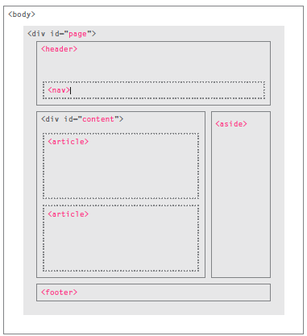
HTML5 layout
<div> element
<header>
<nav>
<aside>
<article>
<footer>

Slide 12
Working with images

Slide 13
How to add images
In the same folder
in a subfolder of the page referencing it
somewhere else on the World Wide Web
Attributes
alt adding an alternative description.
width and height size frame the image.
<img src=”image.jpg" />
<img src="images/me.jpg"/>
<img src=”../ images/me.jpg"/>
<img src="http://www.apple.com/apple.jpg" />
Notes:
C4
13

Slide 14
Hyperlinks
An Hyperlink
<a href="url">link text</a>
Create a bookmark
allow readers to jump to specific parts of a Web page
first create the bookmark
<h2 id=”book”> my books</h2>
Then link it
<a href=”#book">see my book list</a>
Target attributes
target="_blank” – open a new tab
target=”_self “ - open same window/frame
Notes:
C5
14

Slide 15
List elements
<ul>
<li>List 1</li>
</ul>
UL (bullet)
OL (number)
DL (definition/description)
<ol>
<li>List 1</li>
</ol>
<dl>
<dt>Term 1</dt>
<dd>Definition of term </dd>
</dl>
Notes:
C6
C7
C8
15

Slide 16
Tables
Properties
width= “763px” define the width of the table
height = “99px” define the height of the table
rowspan= cell span many rows
border =1 to define a border
valign/align, vertical and horizontal alignment valign="middle" , align="center"
bgcolor = “#597172” define the background color of the table
colspan = "2” = cell span 2 columns
<table width="763px" border="1" align="center" cellpadding="5" cellspacing="3”>
<tr align="center" valign="middle" bgcolor="#597172”>
<td height="99" colspan="2”>
Notes:
C9
16

Slide 17

Forms
Enables you to collect information from users
action=“Where you send the information ”
method=“GET open information
POST long information or sensitive data”
<form >
<input type=“” text=“”>
specifies the HTTP method
Username :
Password :
Login
Welcome to your website
</form>
Notes:
C11
17

Slide 18
HTML forms
Submit, Reset and image Buttons
<form>
<input type="submit" name="submit" value="Submit" />
<input type="reset" name="reset" value="Reset" />
<input type="button" name="ok" value="OK" />
<input type="image" name="imagebutton" src="/html/images/logo.png" />
</form>
Notes:
18

Slide 19
Multimedia elements
video
audio
<video src="media/video.mp4"
controls loop autoplay>
</video>
<audio src="media/sound.wav"
controls loop autoplay>
</audio>
Notes:
C6
C7
C8
19

Slide 20
Additional information

Slide 21
Image formats
pixel-based graphics
Resolution and size influence the quality of the information
Think in pixels: Resolution 72px, 92px
Format
.gif
bitmap image format, supports animations, compressed image without degrading the visual quality
.png
Raster graphics format, created to replace GIF format
Format .jpg
Images with color (photos)
Compress image, can lose information
Vector graphics
represent geometrical primitives
points, lines, curves, and shapes or polygons
can be magnified infinitely without loss of quality,

Slide 22
HTML color modes
Color Names
To be more specific, use Hexadecimal codes
#FFCC00
Can be shortened to three letters if they're
the same #FC0
Newer browsers can use
rgb(0,0,0,0.5);
http://www.color-hex.com
http://www.w3schools.com/tags/ref_colornames.asp
http://www.w3schools.com/tags/ref_colorpicker.asp

Slide 23
HTML tags
http://www.w3schools.com/tags/ref_html_dtd.asp

